Slide 1
What are the defining characteristics of Cloud?
On-demand self service
Distributed storage
Rapid elasticity
Automated management
Broad network access
Resource pooling
Measured service
Virtualization technology

Slide 2
What are the three accepted types of Cloud Computing Services?
Infrastructure-as-a-Service (IaaS) – hardware controlled by the provider … EVERYTHING ELSE controlled by the customer
Platform-as-a-Service (PaaS) – 50/50 split … IaaS +O/S controlled by provider … Application’s & IDE controlled by customer
Software-as-a-Service (SaaS) – EVERTYTHING EXCEPT data and user access is controlled by the provider

Slide 3
What are the Cloud Deployment Models?
Private - infrastructure is provisioned for exclusive use by a single organization.
Public - infrastructure is provisioned for open use by the general public.
Hybrid - infrastructure is a composition of two or more distinct cloud infrastructures (private, community, or public).
Community - infrastructure is provisioned for exclusive use by a specific community of consumers from organizations.

Slide 4
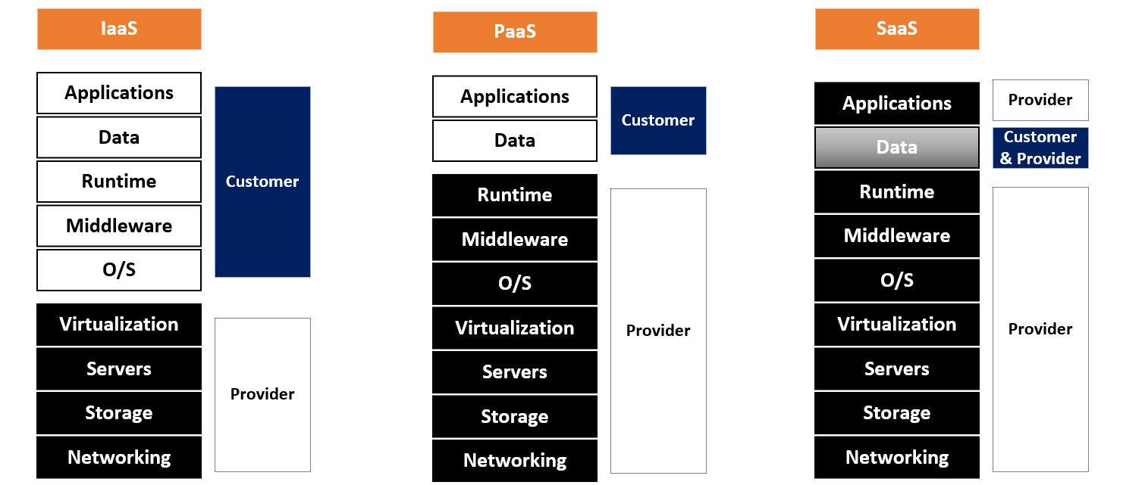
What are the separation of responsibilities in the Cloud?

Slide 5
What are the roles/actors defined by the NIST Cloud Reference Architecture? (SP 500-292)
Cloud Consumer - A person or organization that uses cloud computing services
Cloud Provider - A person or organization providing services to interested parties
Cloud Carrier - An intermediary for providing connectivity and transport services between cloud consumers and providers
Cloud Auditor - A party for making independent assessments of cloud service controls and taking an opinion thereon

Slide 6
What are the roles/actors defined by the NIST Cloud Reference Architecture? (SP 500-292)
Cloud Broker - An entity to manage cloud services in terms of use, performance, and delivery who also maintains relationship between cloud providers and consumers
o Service Intermediation - Improves a given function by a specific capability and provides value-added services to cloud customers
o Service Aggregation - Combines and integrates multiple services into one or more new services
o Service Arbitrage - the services being aggregated are not fixed (cloud broker has the flexibility to choose services from multiple agencies)

